Slide 1
OptaPlanner
Architecture Patterns

Slide 2
Instruction for the User
Build the Solver File – specify the domain classes, the score method and select optimization algorithms (setting a time limit);
Write the Domain Classes related to the problem using annotations (@planning entity, @planning variable);
Create Solution Class, which is the class to be presented to the user when the best solution is found, using annotations (@planningScore, @planningSolution, @planningentitycollectionproperty);
Implement interface score – override calculateScore method. This defines the score to a solution class.
Define constrains using classes or using Drools rules.

Slide 3
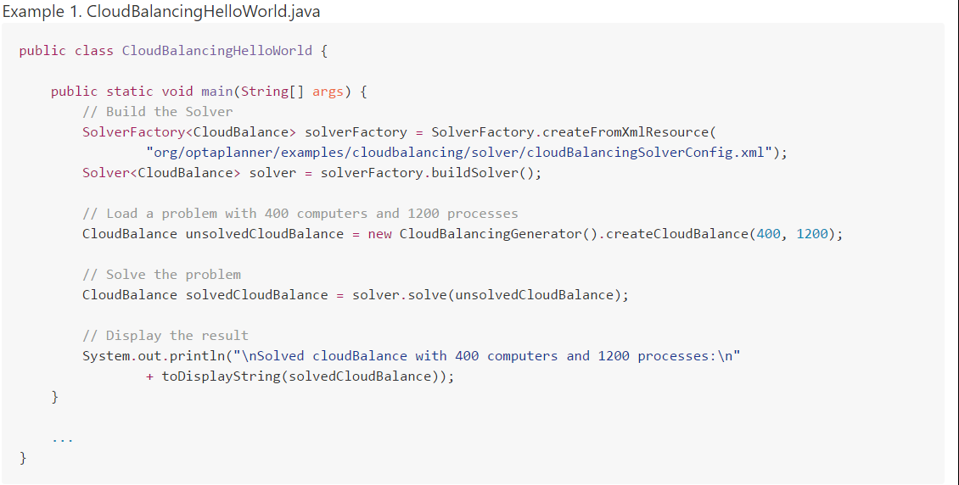
Inversion Of Control – Proofs
o optaplanner concentra em si o controlo do programa, apesar do utilizador definir as instruções e algoritmos.

Slide 4
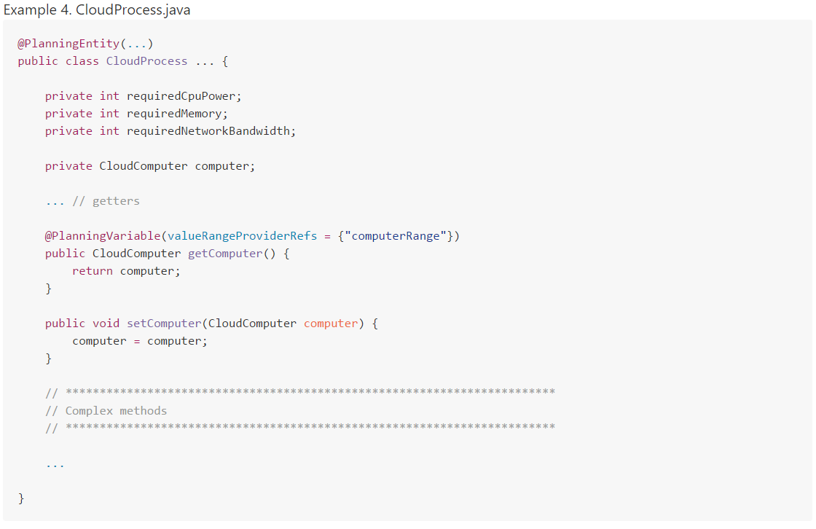
Inversion Of Control – Proofs
o utilizador tem de definir as classes de modelo, utilizando as anotações do optaplanner. ainda tem de definir as condições, a classe de solução, o método de cáculo do score (quanto maior o score, melhor é a solução) implementando uma interface.

Slide 5
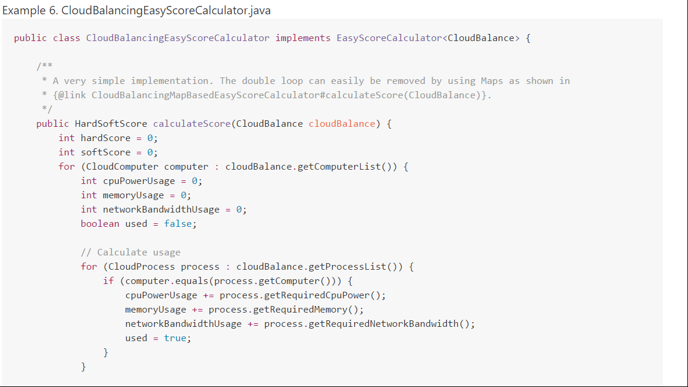
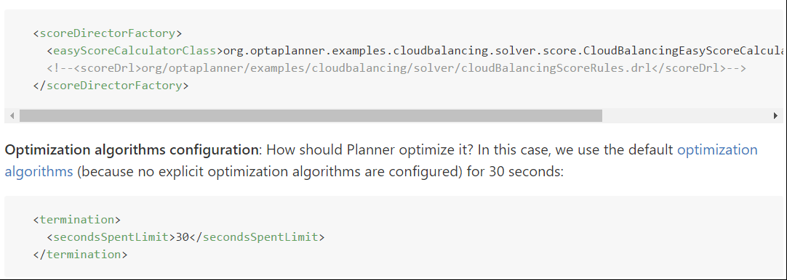
Inversion Of Control – Proofs
Dependecy Injection Frameworks are designed to make use of DI and can define interfaces (or Annotations in Java) to make it easy to pass in implementations.
Inversion of Control Containers are DI frameworks that can work outside of the programming language. In some you can configure which implementations to use in metadata files (e.g. XML) which are less invasive. With some you can do IoC that would normally be impossible like inject implementation at pointcuts.
Reference: http://stackoverflow.com/questions/6550700/inversion-of-control-vs-dependency-injection

